Slide 1
True t₁ Classification
Bobby Yang

Slide 2
Introduction
Modelling malignant tumors
Cancer is not homogeneous process
Different groups (clones) grow and mutate at different rates
Groups arrive at different times while cancer is formed
Interested in estimating arrival times
Estimate times by summary statistics
Single cell DNA sequencing data
Matrix: cells columns, mutation sites rows
Inserts NA values, false positives, false negatives

Slide 3
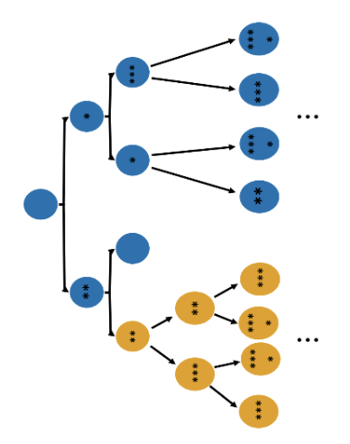
Introduction
Simulation: start with single cell
Divide, die, mutate with rates b_{i}, d_{i}, θ_{i}
At time t₁, one cell gains mutation that gives it an advantage, “clone 1”
Carry its “selective” mutations to its progeny
Repeats m times before tumor observed
End of time (t_{m+1}), sample cells, get summary statistics from single cell DNA sequencing
Simulated data: know true values of arrival times
Find patterns between summary statistics and true t₁

Slide 4
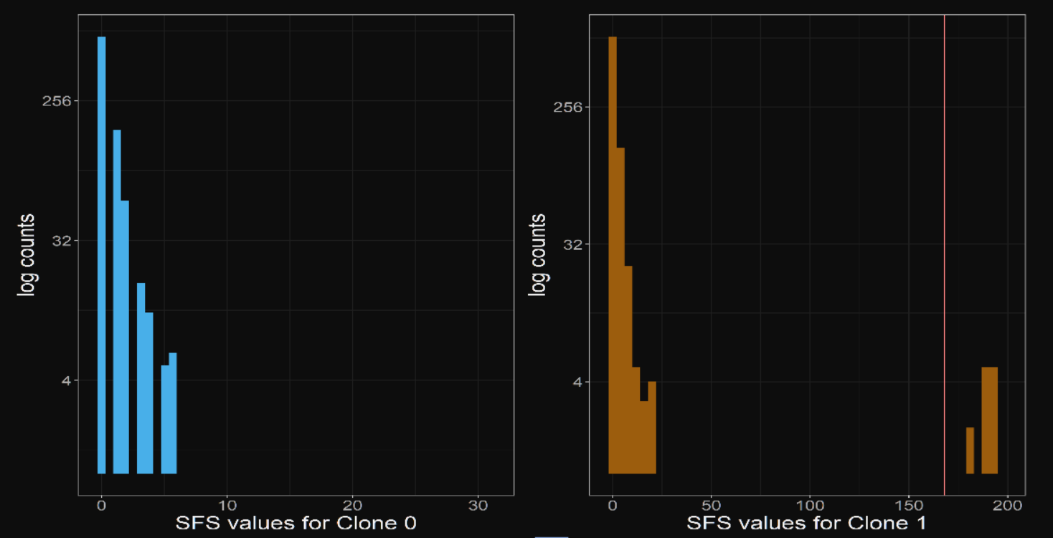
Introduction
Example: two clones
K₁ - mutations present in >α% cells of clone 1
A₁ - mutations present in <α% cells of clone 1
A₀ - all mutations in clone 0
No mutations shared among all cells in sequencing data
p₀/p₁ - proportion of cells in clone 0/1
t_{m+1} - age of tumor
n - sample size
θ - (estimated) mutation rate

Slide 5
Models
Use summary statistics to estimate arrival times of each tumor
Simulation - get true times
Classification - low/high t₁ groups (250-400, 700-900)
Logistic regression (none, ridge, lasso penalties)
Support vector machine (linear, radial, polynomial kernels)
Heuristic method (line)
Comparison of model accuracy - all models cross-validated

Slide 6
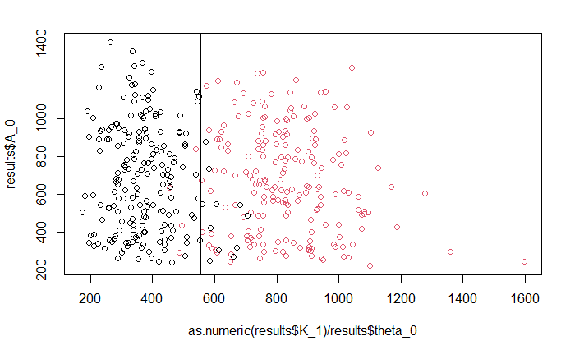
Truth data
No errors in data, ”base” conditions
Line method CV accuracy: 0.95
Logistic CV accuracy: 0.955
Log, ridge accuracy:
Log, lasso accuracy:
SVM:

Slide 7
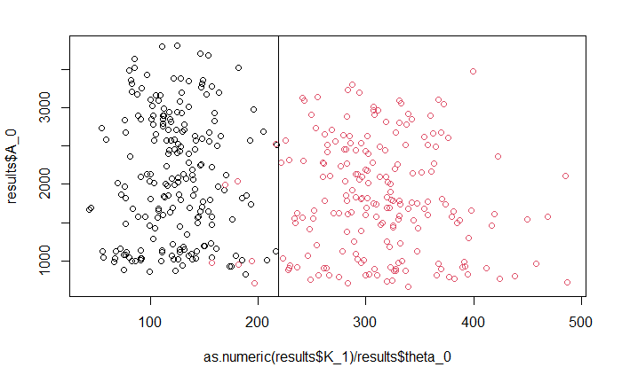
Single cell data
Inserts missing/inaccurate values
False positive rate: .001
False negatives: .05
NA values: .05
Line method CV accuracy: 0.98
Logistic CV: .95
Log, ridge: .9425
Log, lasso: .9425
SVM: .9475

Slide 8
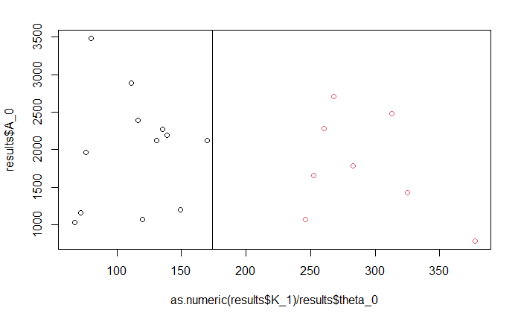
Low n (n=20)
Randomly sample 20 observations
Line method: .9
Logistic: .95
Logistic, ridge: .95
Logistic, lasso: .8
SVM: .85

Slide 9
Collinear predictor
Adds a predictor R = ~0.7 with K_1
Line: .98 (same)
Logistic: .945
Logistic, ridge: .9425
Logistic, lasso: .9475
SVM: .9475

Slide 10
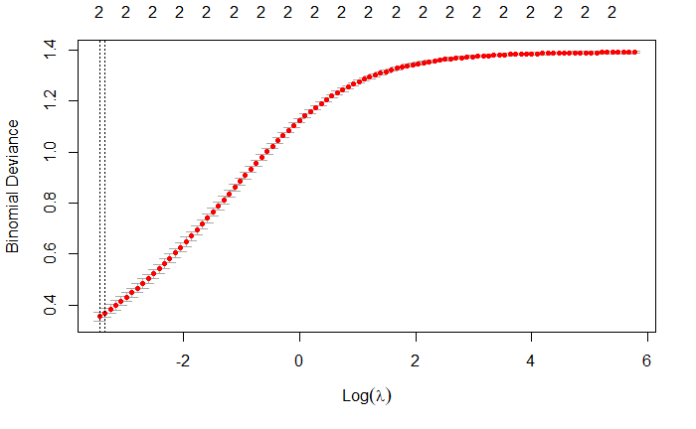
Changing lambda, ridge
Optimal lambda: .9425
Optimal * 10^1: .9425
Optimal * 10^2: .9475
Optimal * 10^3: .74
Optimal * 10^-1: .945
Optimal * 10^-2: .9475
Optimal * 10^-3: .95

Slide 11
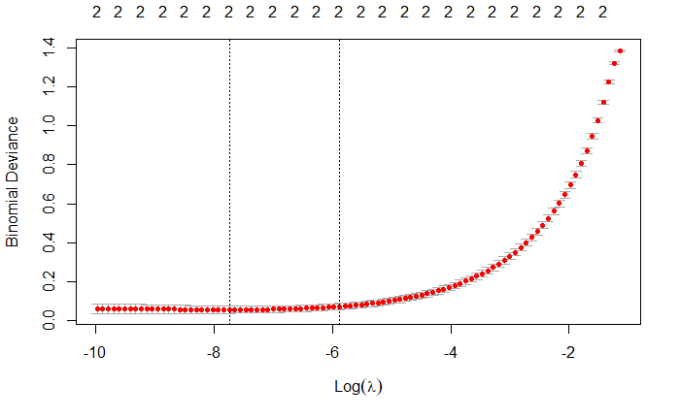
Changing lambda, lasso
Optimal lambda: .9425
Optimal * 10^1: .565
Optimal * 10^2: .485
Optimal * 10^-1: .9475
Optimal * 10^-2: .95
Optimal * 10^-3: .95

Slide 12
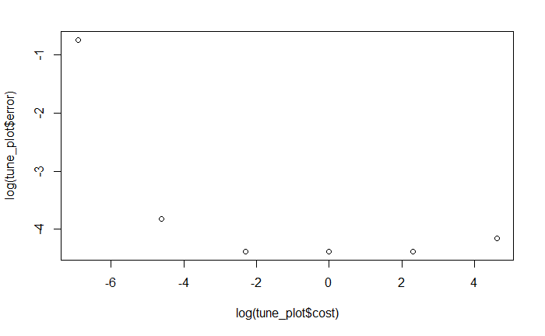
Changing SVM cost
Optimal cost = 0.1: .94
.001: .94
.01: .9375
1: .9375
10: .835
100: .9275

Slide 13
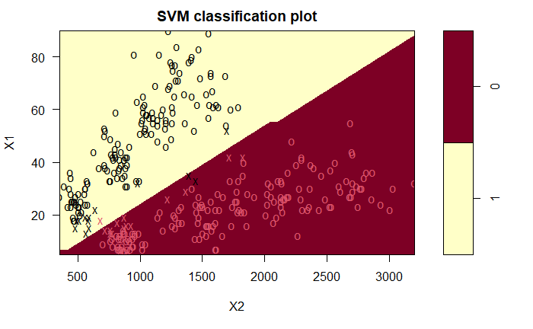
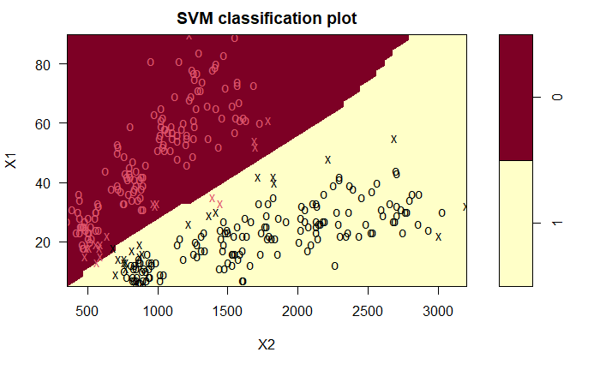
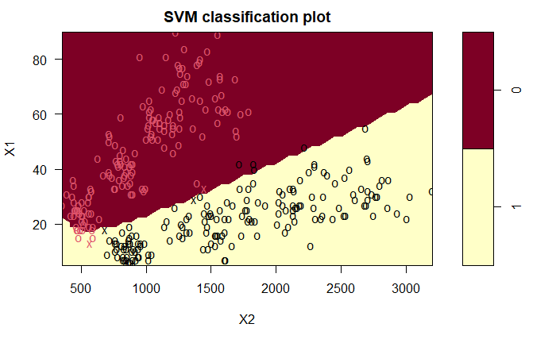
SVM kernels
Linear
Linear kernel: .94
Polynomial: .8075
Radial: .945
Optimal cost
Radial
Polynomial

Slide 14
Conclusions
Line method performed fairly well, almost all >0.9
Scale to varying parameters from simulation
Logistic - fairly accurate, ~0.95
Including more variables generally resulted in better fit (possible overfitting)
Ridge/lasso penalty not necessarily better
Increasing lambda tended to worsen performance
Linear + radial SVM kernel performed best
Boundary should be roughly linear, but polynomial can approx. linear?

